Slide 1


Introduction to Psychology
"Scientific study of the mind and behavior."
Presented by Djeffal narimene

Slide 2

Goals of Psychology
  Understanding Behavior
  Prediction of Behavior
  Control or Influence of Behavior

Slide 3


Research Methods
Experimental Research
Correlational Research
Descriptive Research
  Manipulating Variables
  Example: Impact of Sleep on Memory
  Examining Relationships
  Example:Study Habitsand Academic Performance
  Observing and Describing Behavior
  Example: Case Study on Learning Challenges

Slide 4
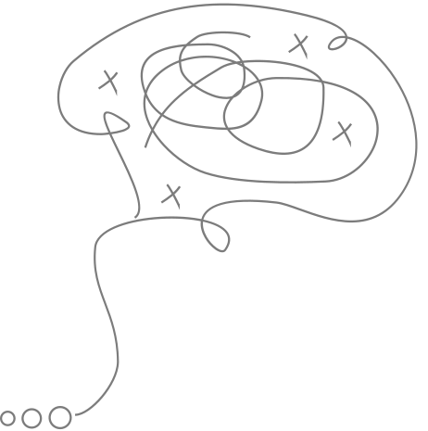
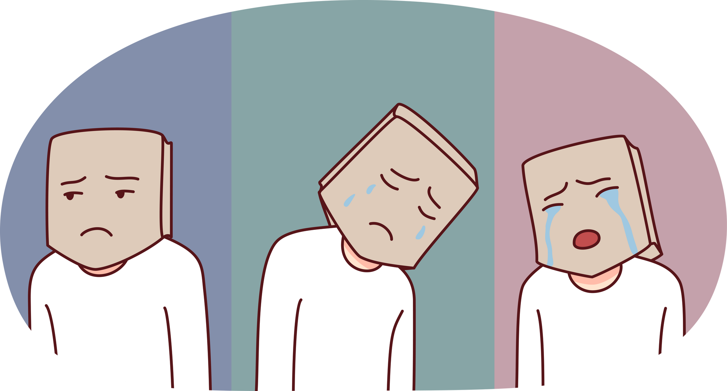

Applications of Psychology
Clinical Psychology
Industrial-Organizational Psychology
Educational Psychology

Slide 5

Conclusion

Slide 6

Thank you very much!
Presented by Djeffal Narimene

