Slide 1
Badji-Mokhtar Annaba university
Introduction in Anthropology phd :Atika Oukil
2025-2026

Slide 2
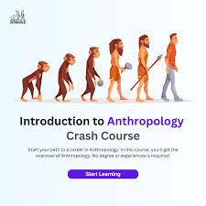
Definition from Anthropology
Anthropology is the study of humans and human societies in all aspects of what it means to be human, in all times and all places.
Anthropology is the scientific study of humanity, concerned with human behavior, human biology, cultures, societies, and linguistics, in both the present and past, including past human species.
Social anthropology studies patterns of behavior, while cultural anthropology studies cultural meaning, including norms and values. A portmanteau term sociocultural anthropology is commonly used today. Linguistic anthropology studies how language influences social life. Biological or physical anthropology studies the biological development of humans.

Slide 3
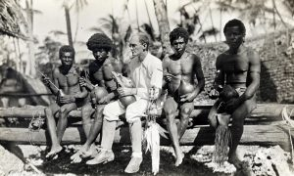
Anthropology, the "science of humanity,“
comprehensively studies human beings, covering aspects from the biology and evolution of Homo sapiens to society and culture . It explores the social and cultural constructs of human groups through cultural, social, linguistic, and psychological perspectives ..

Slide 4
Similar concepts in Anthropology
1- What is Ethnology?
Ethnology is a branch of anthropology focused on the comparative and analytical study of cultures and societies. It contrasts with ethnography, which typically investigates a single culture in depth
2- What is an Ethnography in research?
Ethnography is a qualitative method for collecting data often used in the social and behavioral sciences. Data are collected through observations and interviews, which are then used to draw conclusions about how societies and individuals function.

Slide 5
Some questions that anthropology is trying to answer:
1- Who is a human being and what distinguishes him from other beings.
2- How man evolved (what is the origin of man and how he evolved over the ages)
3- How human society lives.
4- Do human values change over time
5- Where is man headed (what is man's future in light of technological development)
6- How the language originated
7- What is the role of symbols and customs in the lives of societies and how they differ from one culture to another

Slide 6
Goals of Anthropology
To explore the diversity of human forms of social existence and cultural practices worldwide.
To understand the shared biological and behavioral continuity between humans and other species.
To use knowledge of human cultures and societies to help solve contemporary problems and improve welfare .

Slide 7
How does anthropology help solve problems?
It is a crucial field in addressing issues of social justice and inequality, as it helps us to recognize the value of cultural differences and to challenge assumptions about race, gender, and other forms of social inequality.

